Slide 1






CEAL Conference 2015 Chicago
The Web of Data is Our Oyster
Richard Wallis
OCLC Technology Evangelist
@rjw
Notes:
I wan to talk to you today about technology – Linked Data technology.
Not Technology for technology's sake
The application of Linked Data techniques and technology that will deliver benefits and open up opportunities for all libraries in their mission to get your resources to your users.
We all use, and libraries can be part of a Web of data on the internet today, providing those pearls of library curated knowledge for the benefit of our users and the world.
We are experiencing a revolution in discovery – where did I look for the image on this slide – where would you search?

Slide 2
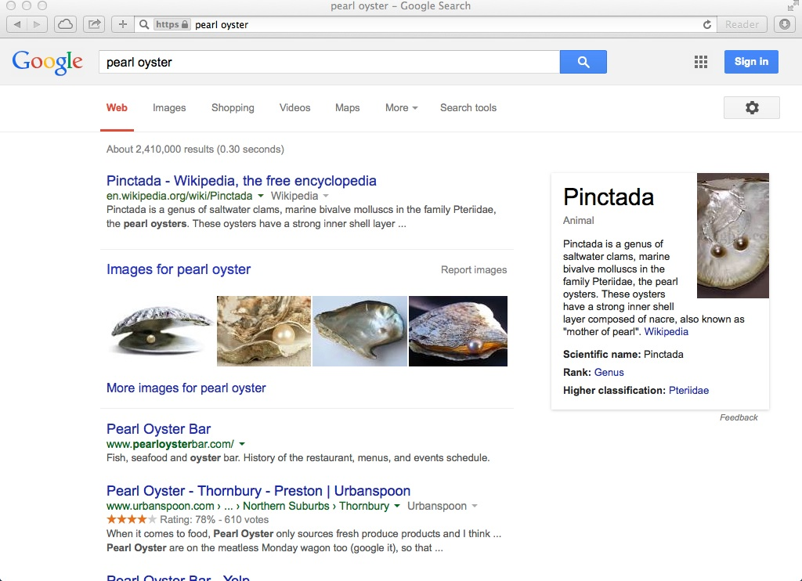
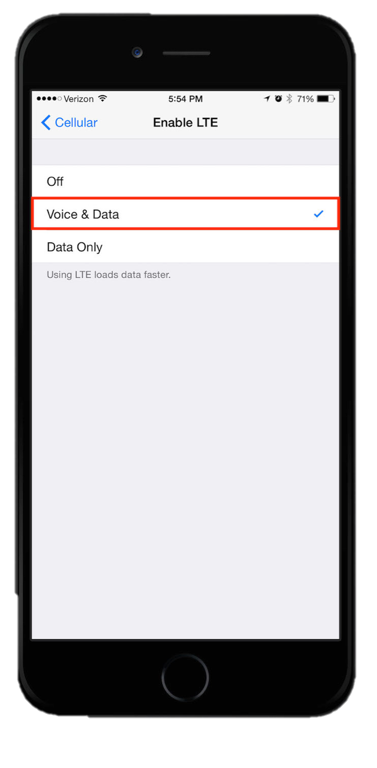
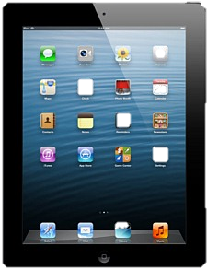
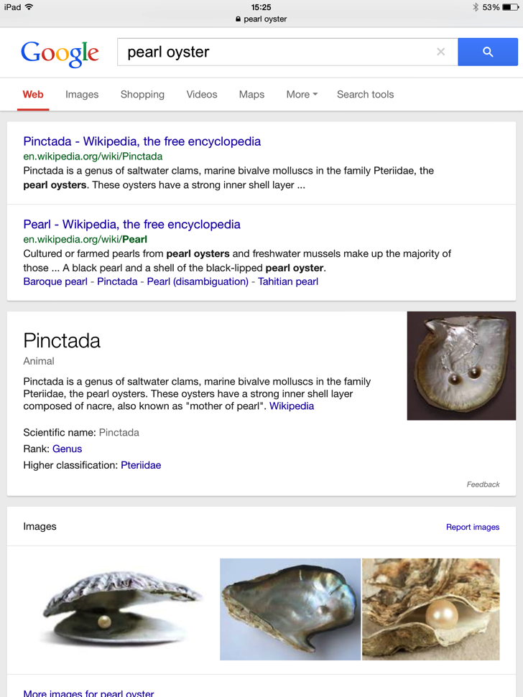
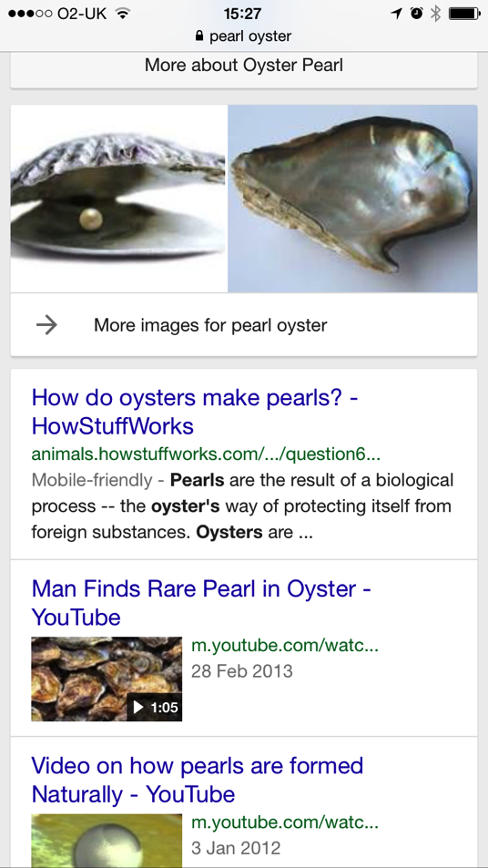
Notes:
Today's de facto start point is the search engines – on your choice of device – not just a web page on a PC screen – on an iPad, phone, or whatever is appropriate at the time.
Today's services being flexible to provide device appropriate experiences.

Slide 3
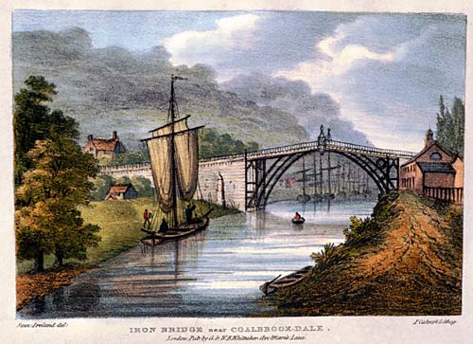
The Industrial Revolution
1779 (c.)
Image courtesy of: Shropshire County Council
Notes:
Lets look back at an earlier revolution – the Industrial Revolution.
'The Iron Bridge' across the River seven in Coalbrook Dale England - an 18th century first visible symptom of a revolution which changed life for everyone.
It is highly unlikely that the men loading that sail barge in the foreground had any concept how the technology behind this wonder of engineering would sweep away the world they knew with steam engines cranes and railways.

Slide 4
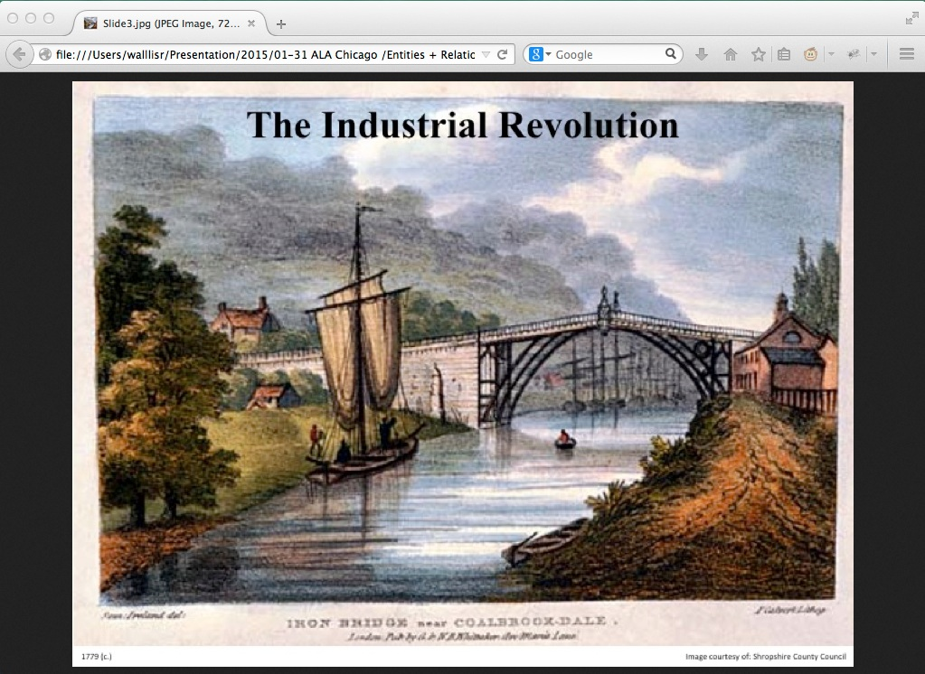
The Web Revolution
Notes:
Skipping forward a few centuries we see the first widely visible of the Web revolution – the browser, demonstrating the ability to be able to view this artwork from our desk instead of having to travel to the gallery in which it Is hung.

Slide 5
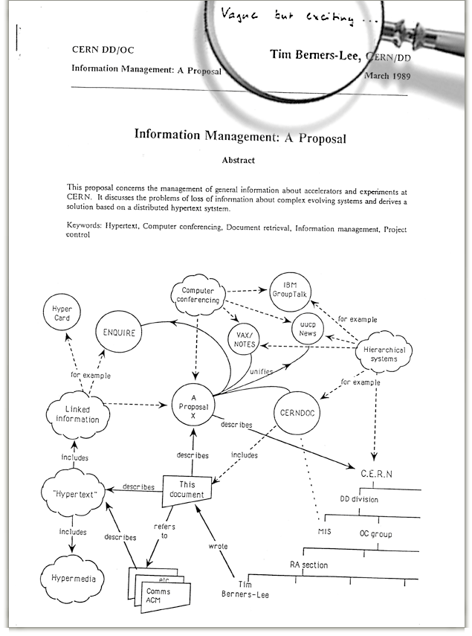
Notes:
This paper was produced in the Coalbrook Dale of the Web revolution – Cern, Switzerland
Where Tim Berners-Lee produced this proposal for what became the World Wide Web
It caries the now famous note from his boss – 'vague but exciting' – the way many of us feel about the web today!

Slide 6
The Web of …
✔
Documents
✔
Active Documents
☌
✗
Discovery
☌
✔✗
Data
☌
Knowledge
?
Notes:
The Web has and continues to evolve:
Linked Documents – documents built on the fly from databases – search engines analyzing the links to create discovery – sites starting to publish the [linked] data behind the documents.
How have libraries engaged with the web:
Enthusiastic & leading for documents – actively disengaged with the search engines (technology issues and commercial concerns) – partial engagement with the web of data.
A Web of knowledge is forming as the search engines analyze the relationships in the data – how will libraries participate?

Slide 7
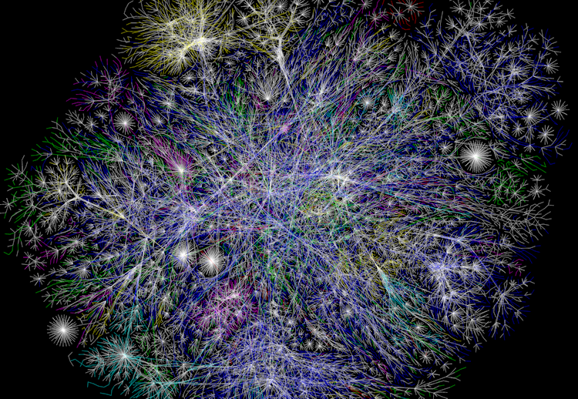
The Web of Data
A Web of related entities
http://www.opte.org/
Notes:
A Web of data has formed:
Built on identified entities and the relationships between them

Slide 8
The Web of Data
A Library Shaped Black Hole ?
http://www.opte.org/
Notes:
With current levels of engagement we are in danger of a library shaped black-hole forming in that web of data

Slide 9
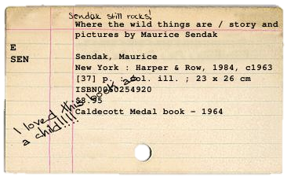
Notes:
Libraries have been at the lading edge of capturing data about resources.
The catalogue card was revolutionary when introduced

Slide 10
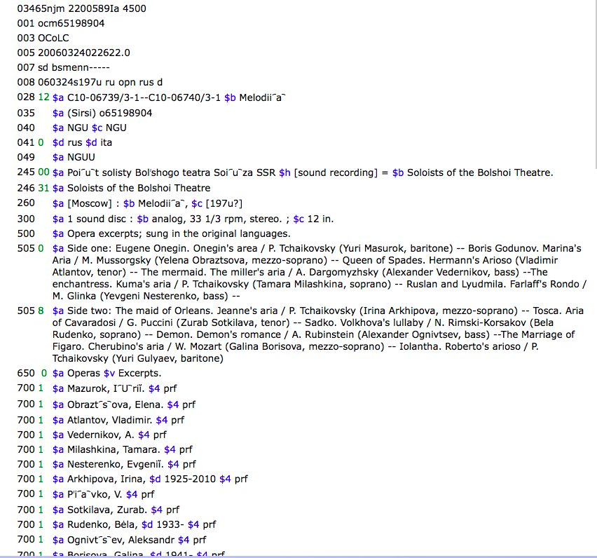
Notes:
The Machine Readable Cataloguing format MARC again was revolutionary when introduced to automate the printing of cards.
We have now relied on this 'card' record format for half a century – is it still appropriate in this entity based world.

Slide 11
record
/ˈrɛkɔːd/
noun
  a thing constituting a piece of evidence about the past, especially an account kept in writing or some other permanent form.

Slide 12
entity
/ˈɛntɪti/
noun
  a thing with distinct and independent existence.
relationship
/rɪˈleɪʃ(ə)nʃɪp/
noun
  the way in which two or more people or things are connected

Slide 13
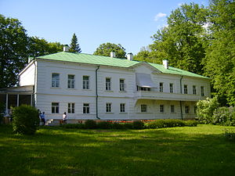
Record
Title: "War and Peace"
Author: "Leo Tolstoy 1828-1910"
ISBN: 0307266931
Entity (http://worldcat.org/entity/work/id/115206288)
Type: Work
Name: "War and Peace"
Author: http://worldcat.org/entity/person/id/1234
⤵︎
Entity (http://worldcat.org/entity/person/id/1234)
Type: Person
Name: "Leo Tolstoy "
Born: 1828
Died: 1910
Birthplace: http://worldcat.org/entity/place/id/8976
⤵︎
Entity (http://worldcat.org/entity/place/id/8976)
Type: Place
Name: "Yasnaya Polyana"
SameAs: http://geonames.org/468686
⟶
Notes:
In a record view you get bits of data [evidence] about an item.
Related entities provide descriptions of real things/entities enabling you to follow the relationships between them – inside and beyond the closed world of libraries

Slide 14
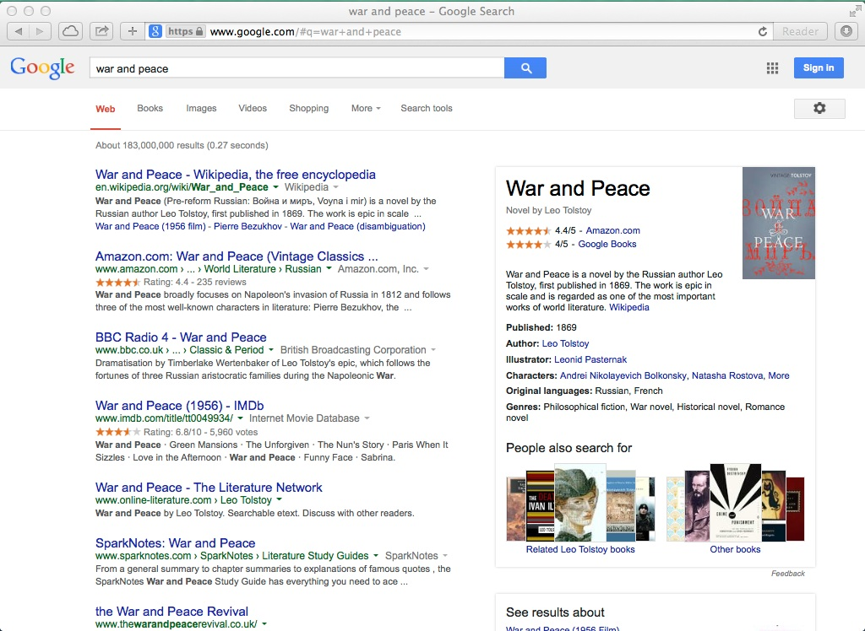
Notes:
Google's knowledge Graph navigating between entity descriptions….

Slide 15
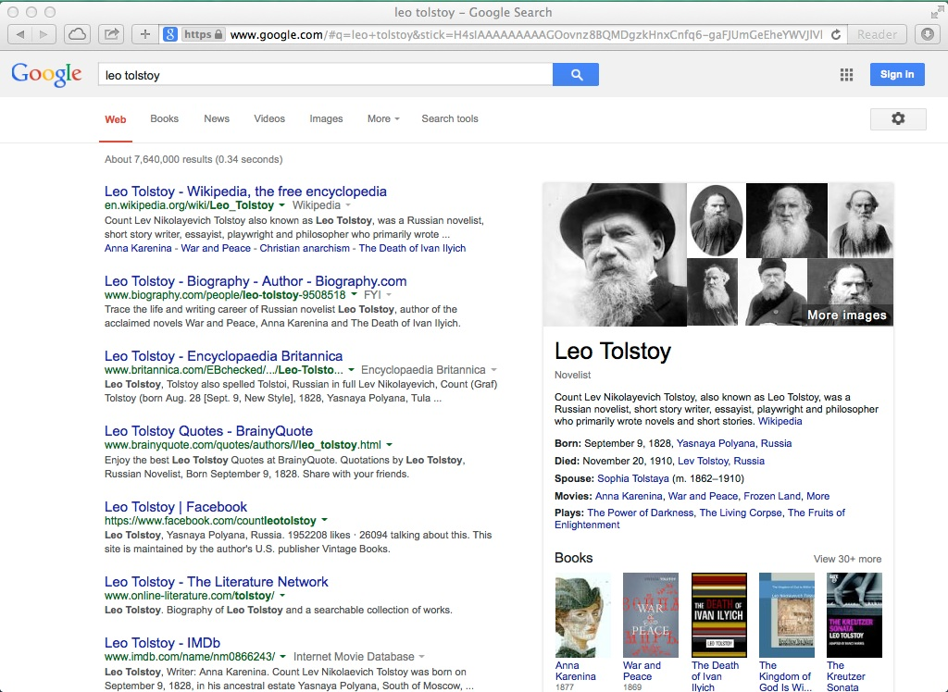
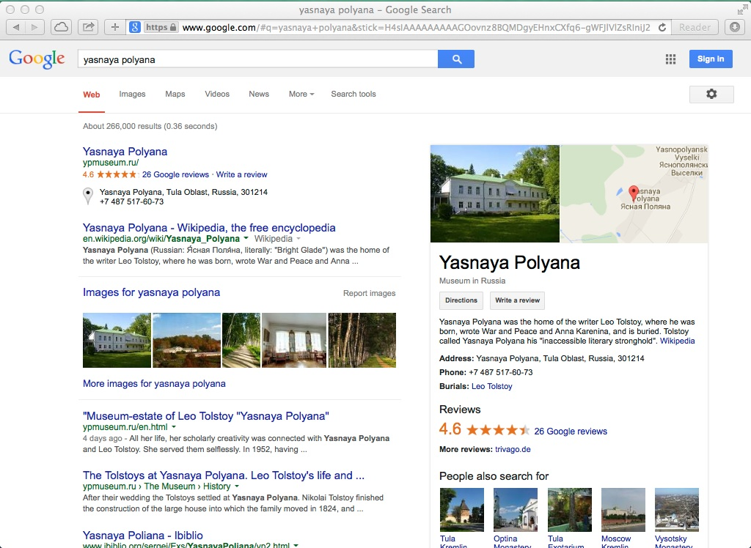

Slide 16
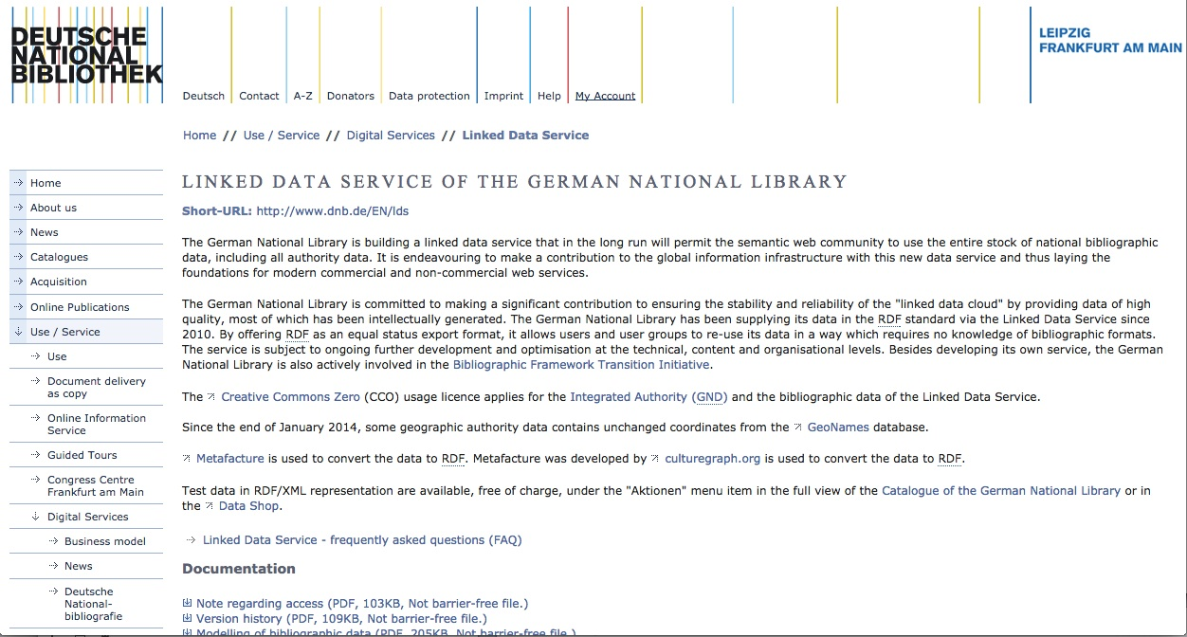
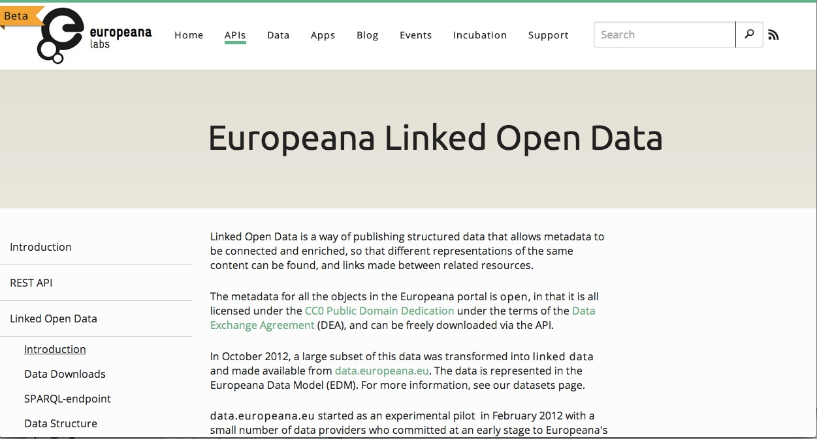
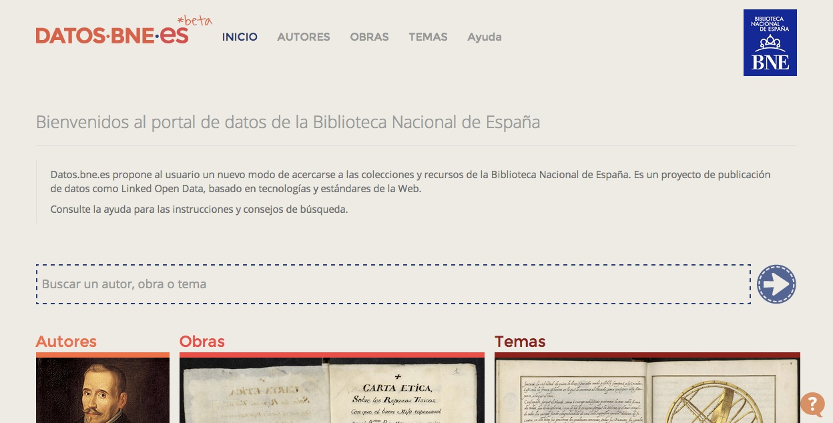
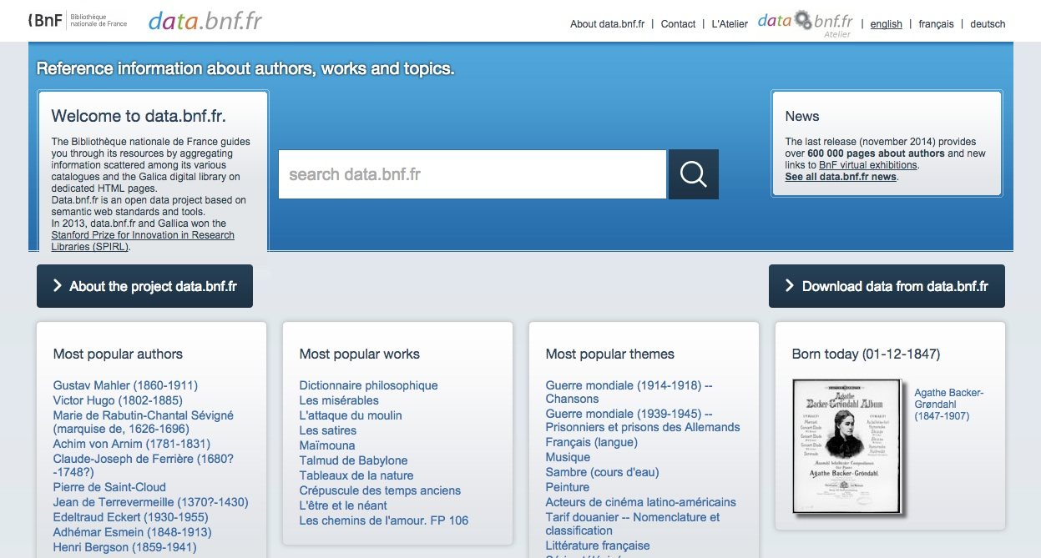
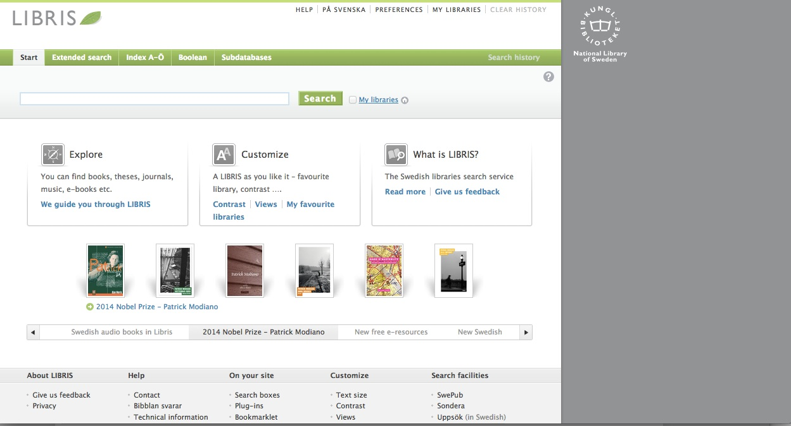
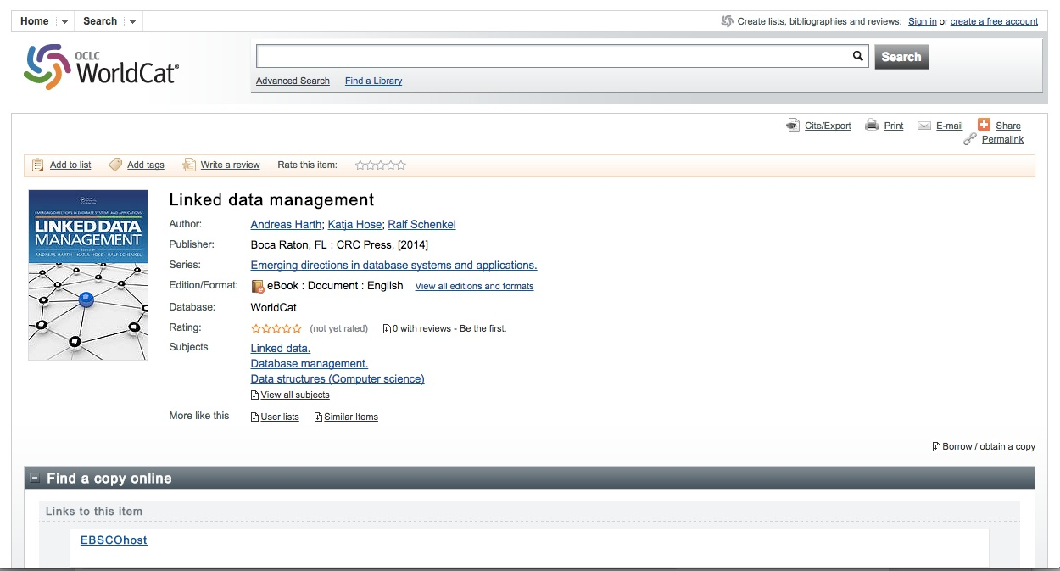
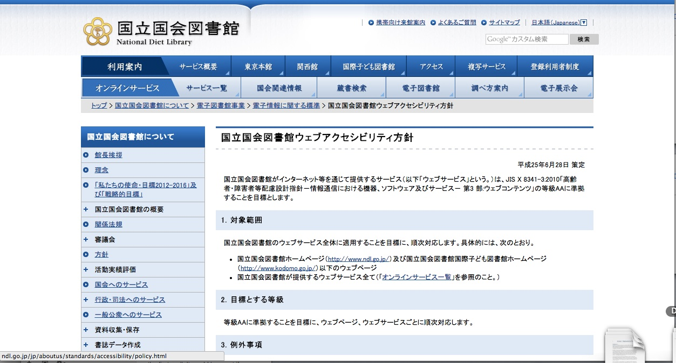
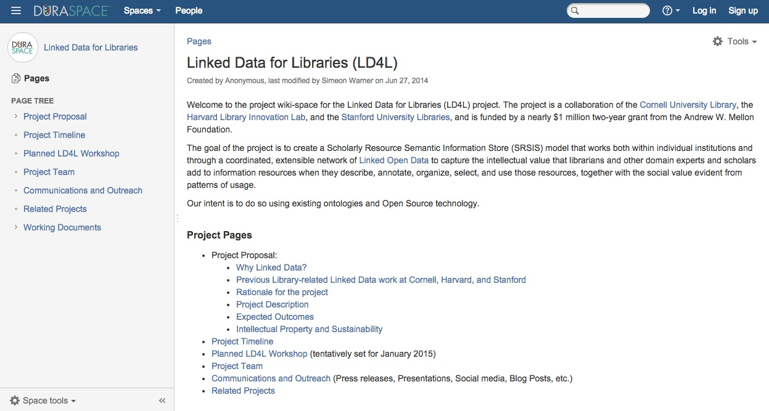
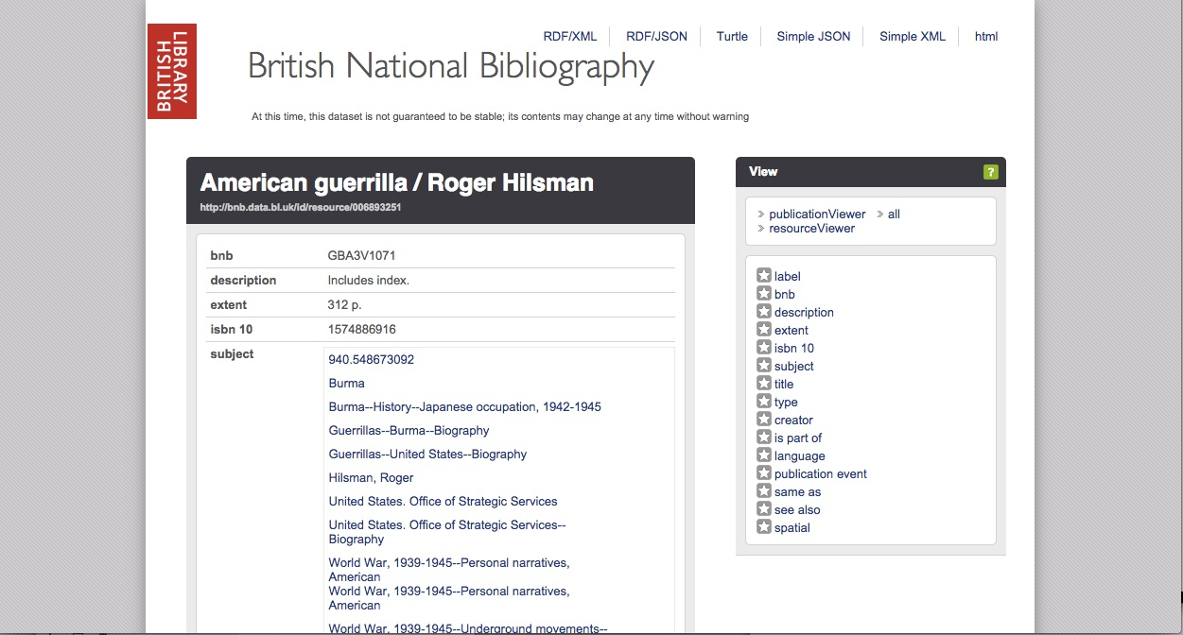
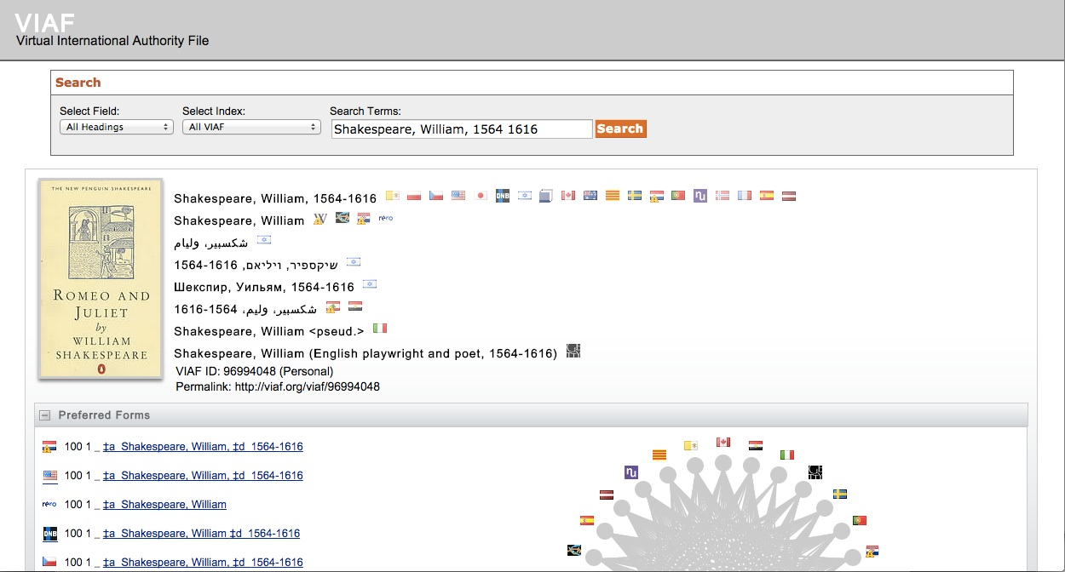
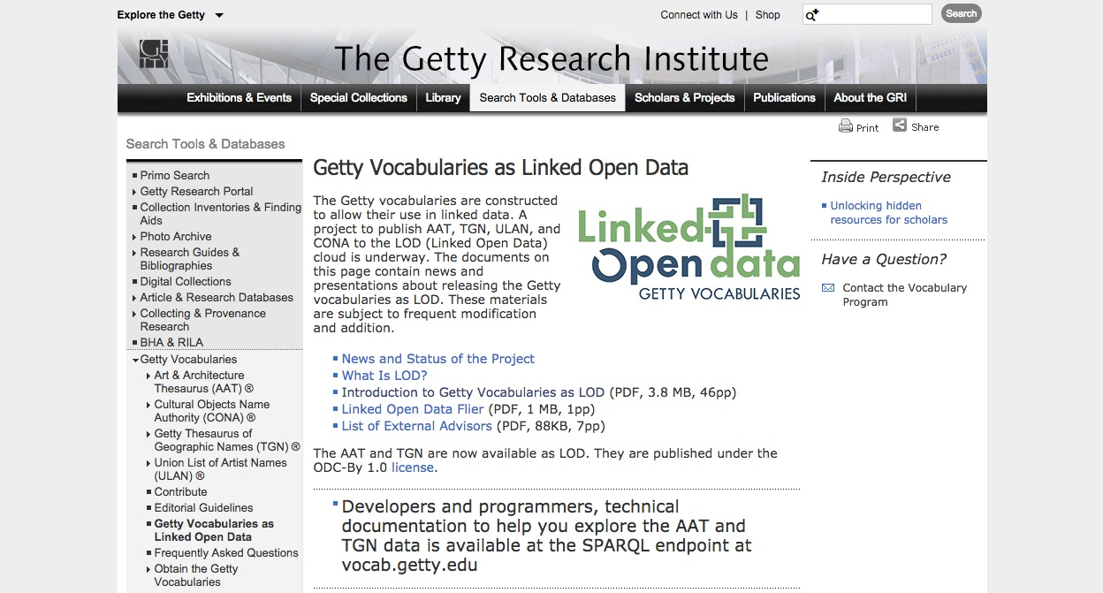
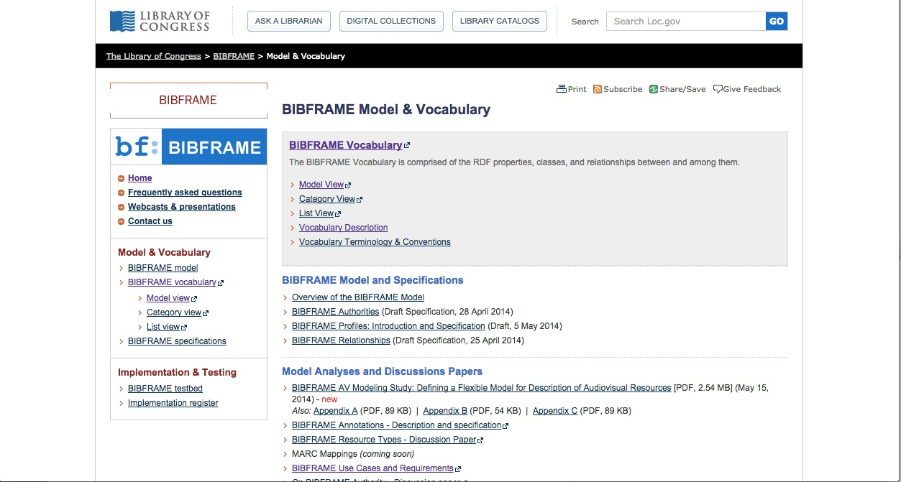
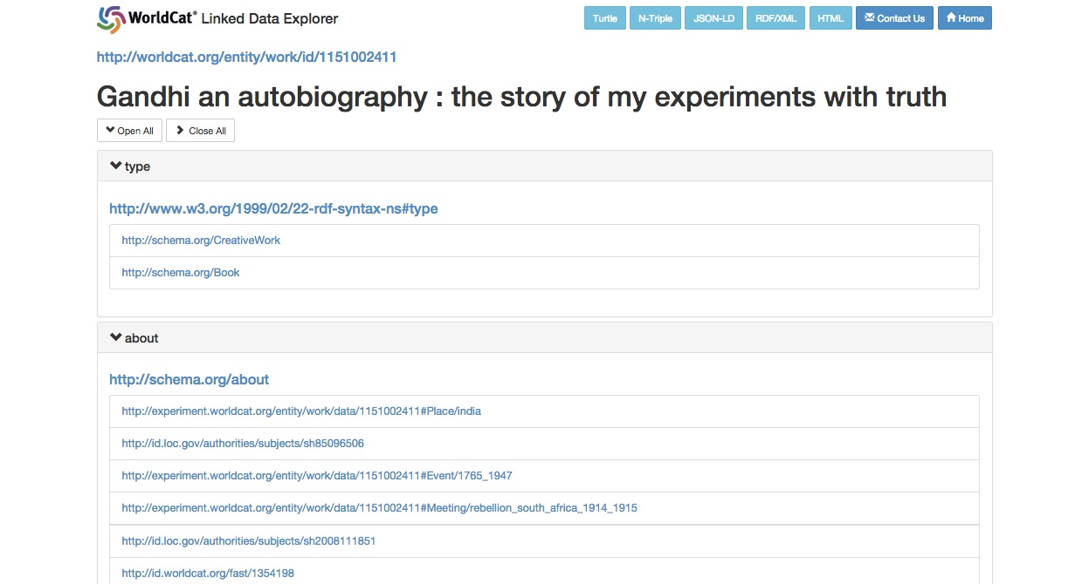
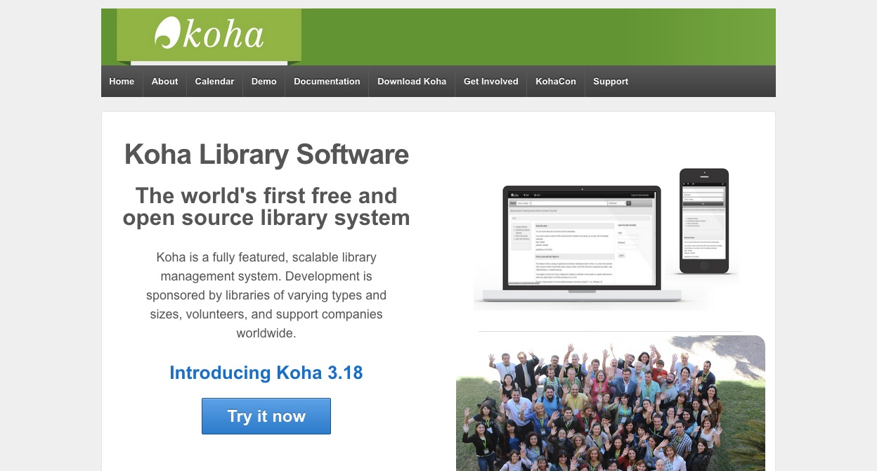
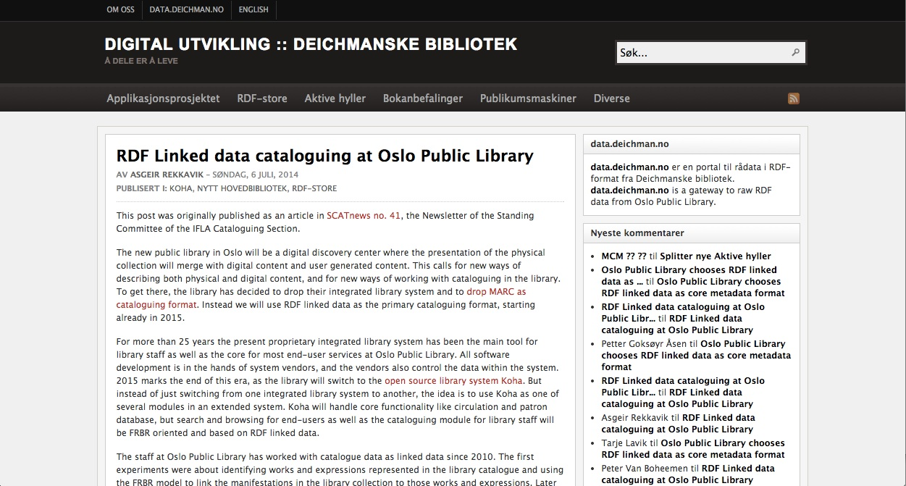
Notes:
There have been many linked data initiatives from individual libraries..

Slide 17
Many great LD Projects
So today …..
Where are we on the web?
Notes:
So what effect on discoverability have these initiatives had?

Slide 18
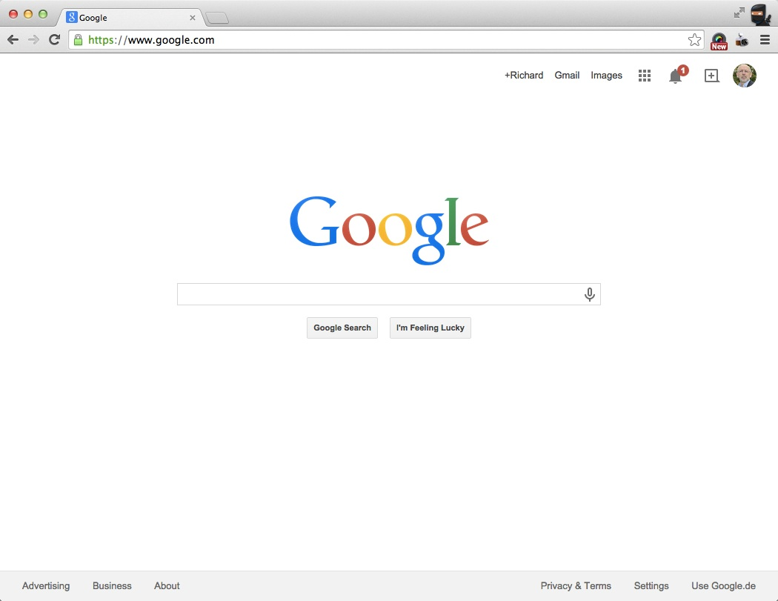
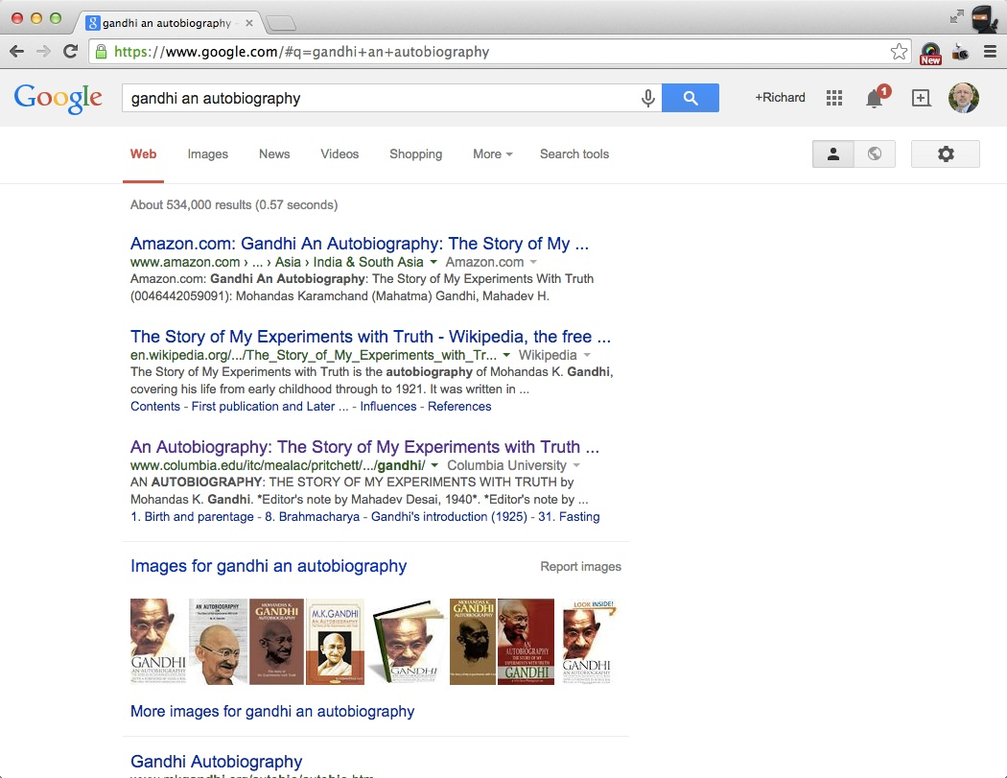
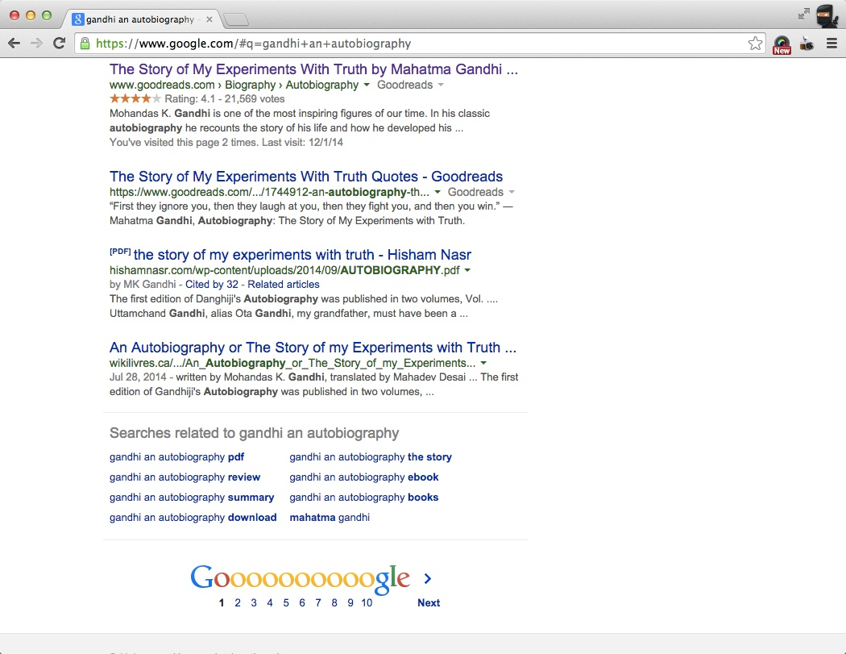
Where are we on the web?
Notes:
Example search – No libraries visible

Slide 19
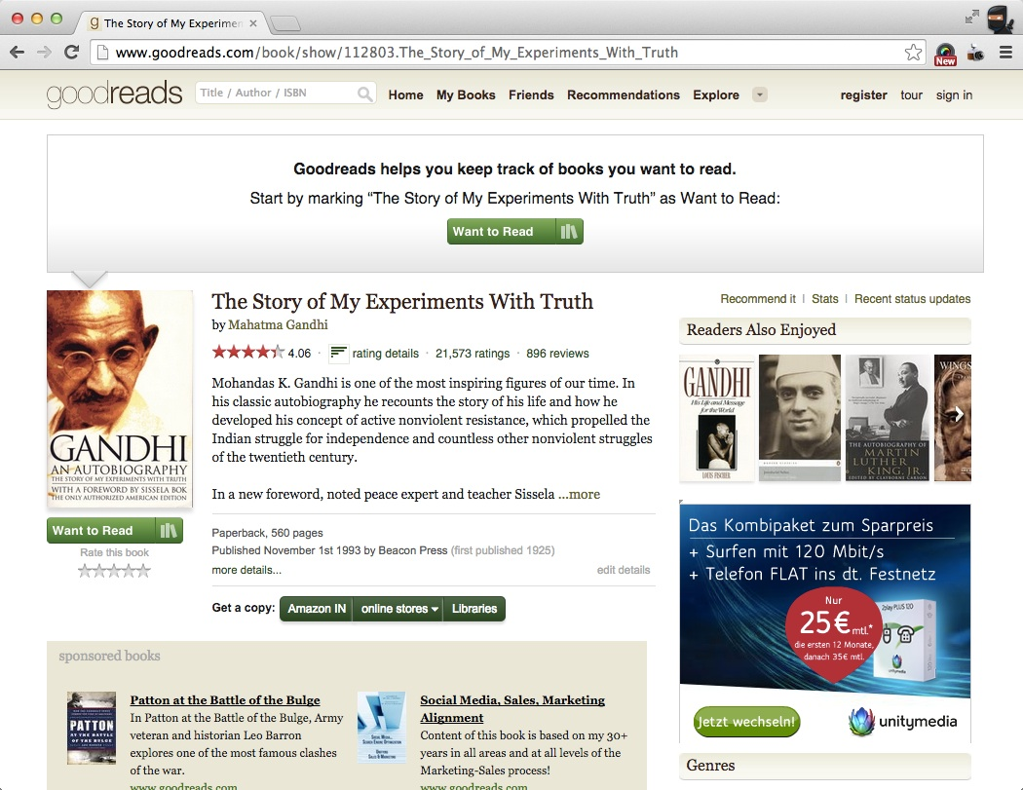
Notes:
If you know where to find it, there is a link in GoodReads

Slide 20
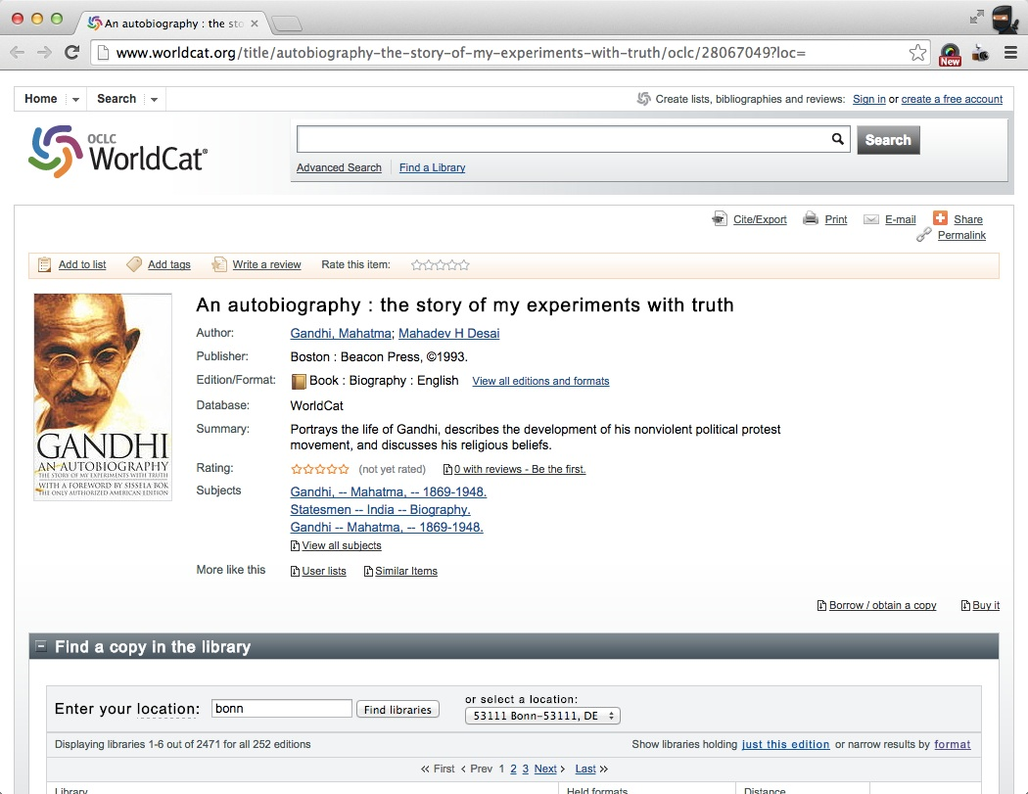
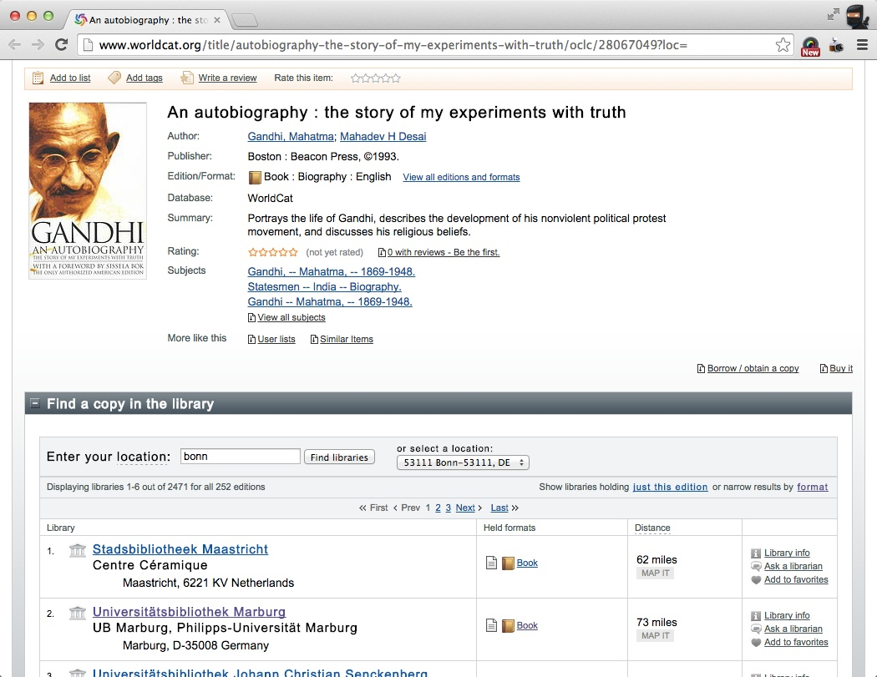
Notes:
Which takes you to OCLC WorldCat, with a link to a library….

Slide 21
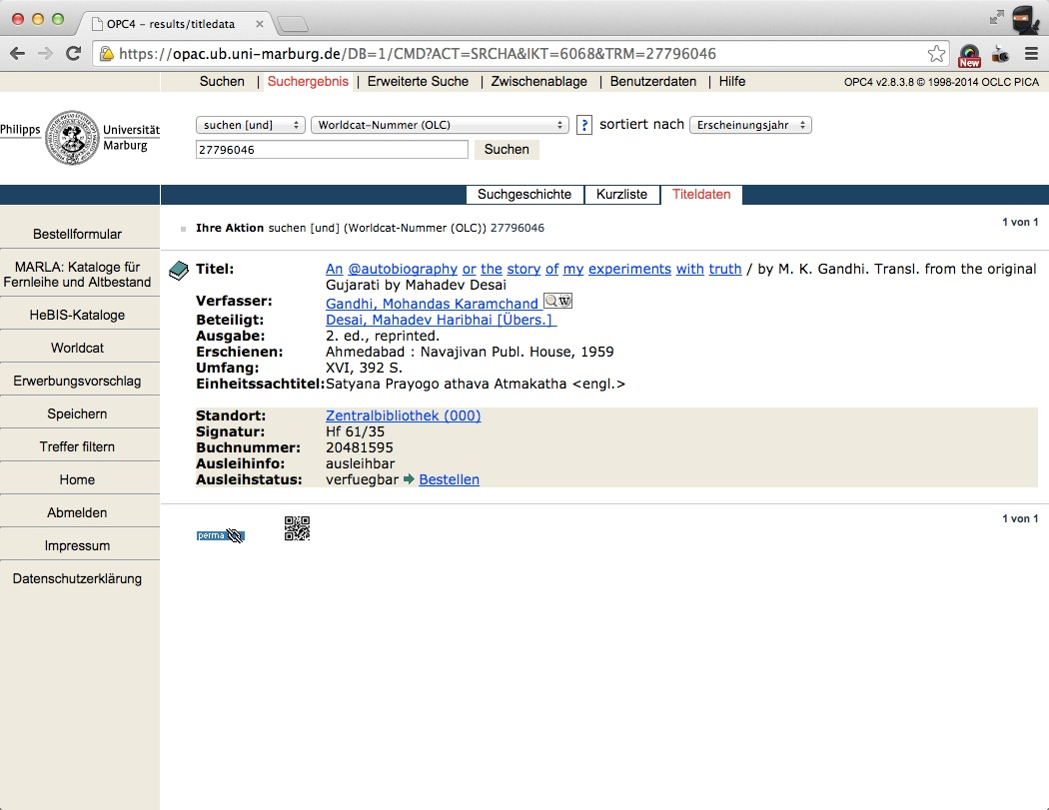
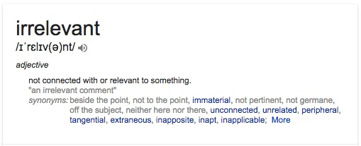
Invisible on the web!
Notes:
… which takes you to an individual library's web online catalogue.
How many are going to persevere? To the vast majority we are invisible – irrelevant – not connected!

Slide 22








Library Linked Data
German National Library
Spanish National Library
Swedish National Library
British Library
Open Linked Data - Silos
Behind A Vocabulary Barrier
Notes:
Why not connected?
These libraries, like many others, have built linked data silos – not linked to each other – not in vocabularies looked for by the web

Slide 23
de facto
A general purpose vocabulary for describing things on the web
y
Linked Data
Embedded in HTML
RDFa, Microdata, JSON-LD
Descriptive data
Active links
"Used by 5 million domains"
"25% of pages in our indexes"
"15% of the Web"
Notes:
The Search engines look for Schema.org, used by a significant part of the web

Slide 24
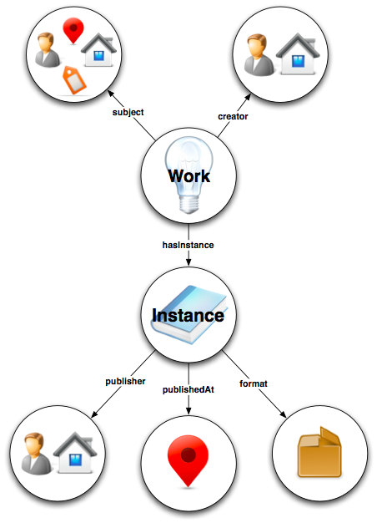

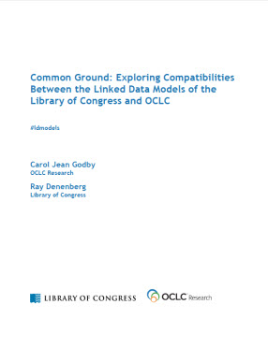
Foundation for the future of bibliographic description
Eventual replacement for Marc 21
Identify information entities
Conversion from Marc
Publish in RDF – Linked Data
White Paper
  Common Ground: Exploring Compatibilities between the Linked Data Models of the Library of Congress and OCLC
http://oc.lc/CommonGround
Notes:
Bibframe is a prominent initiative from LoC.
Focused on bibliographic description and replacing Marc 21
Currently significant emphasis on converting Marc records.
Different starting point than OCLC – start with what the web wants
Checkout the white paper identifying how they are complementary approaches

Slide 25
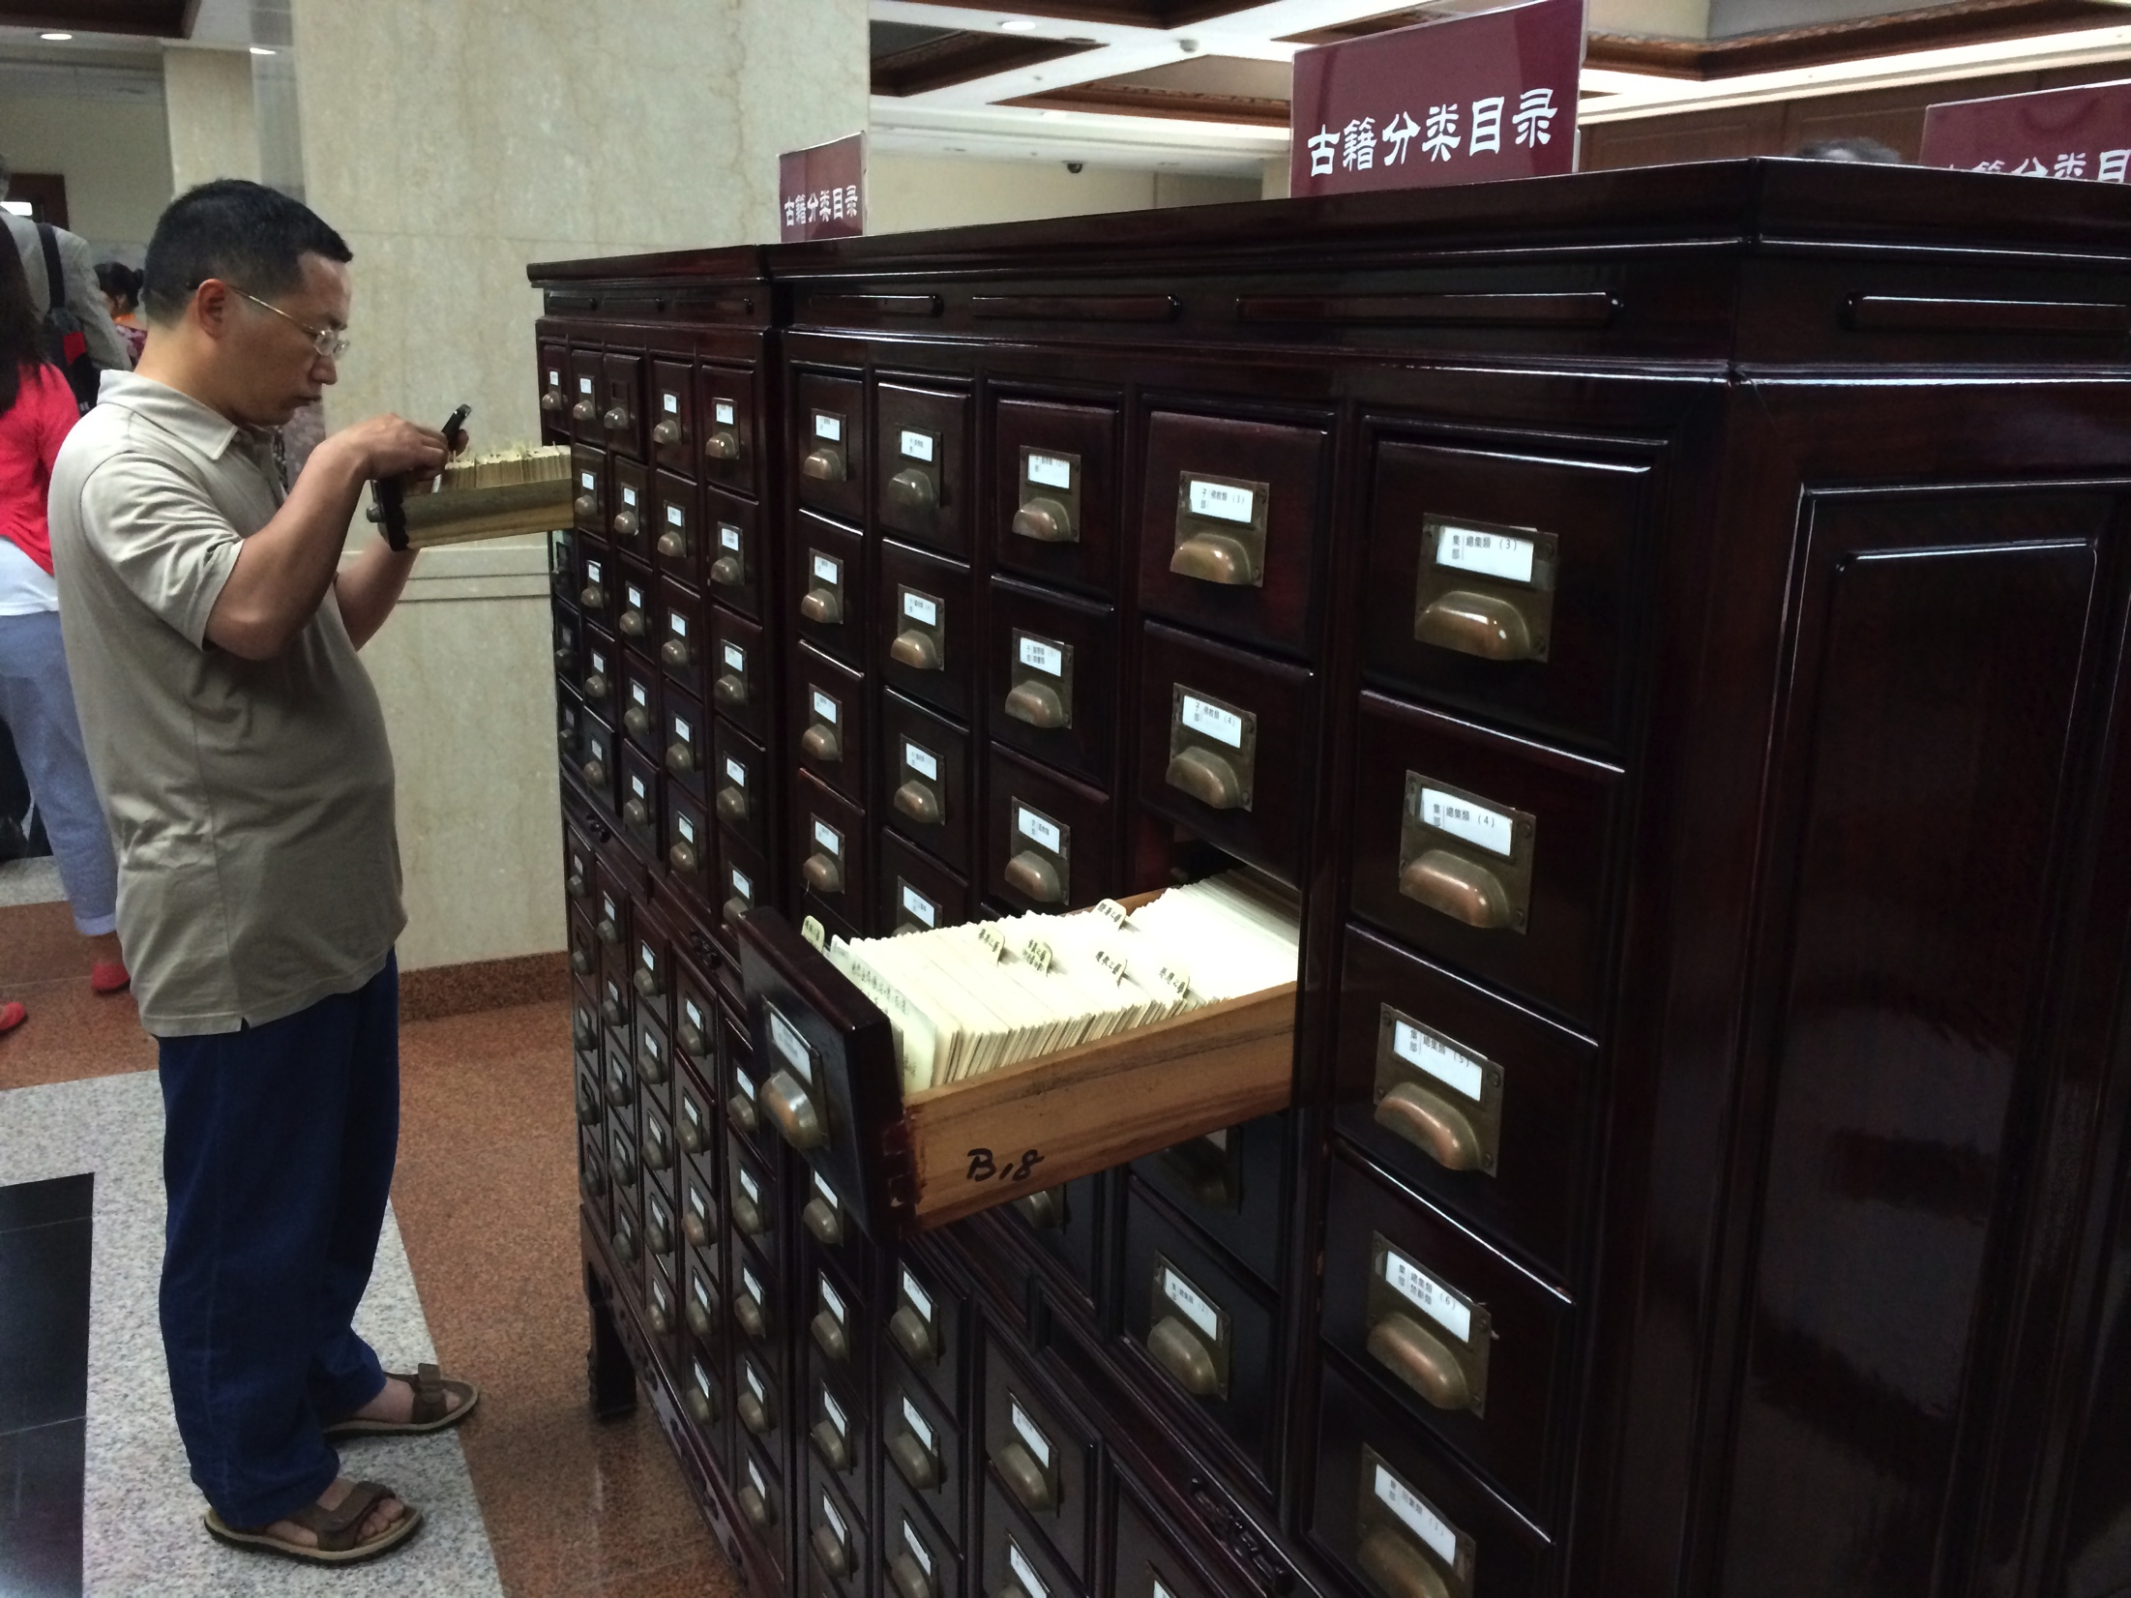
Why Catalog?
So we can find things
Why Share on the Web?
So today’s users
can find our things

Slide 26

Where are our users?

Slide 27


Getting from here to there
Data from one converted record does not an entity make
Transformation into Linked Data is just a beginning …
      Mine and analyze the aggregate
      Identify, map, merge - evidence based
      Relate to external sources
      Establish the entities
Notes:
Just converting individual records to an RDF [linked data] format does not create entities – you need to mine and aggregate the references from within a large body of data.

Slide 28
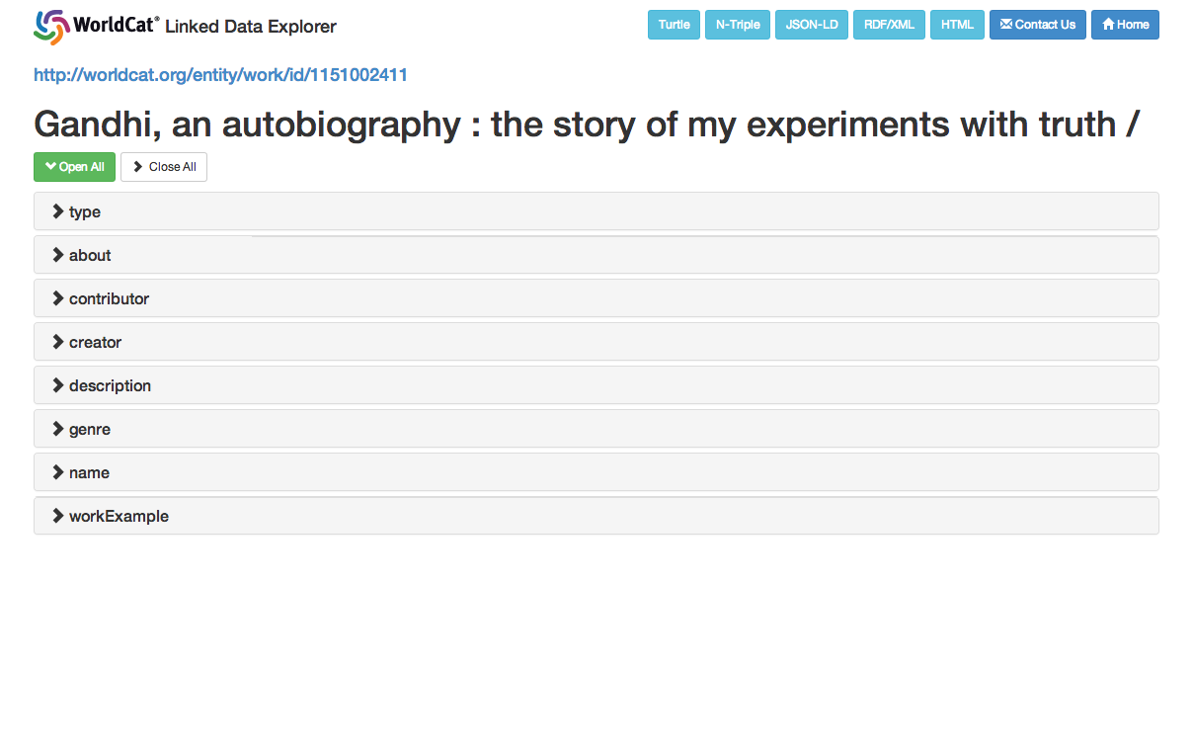
Notes:
The WorldCat Work entity – one of approx 200 million minded from 300+ million records

Slide 29
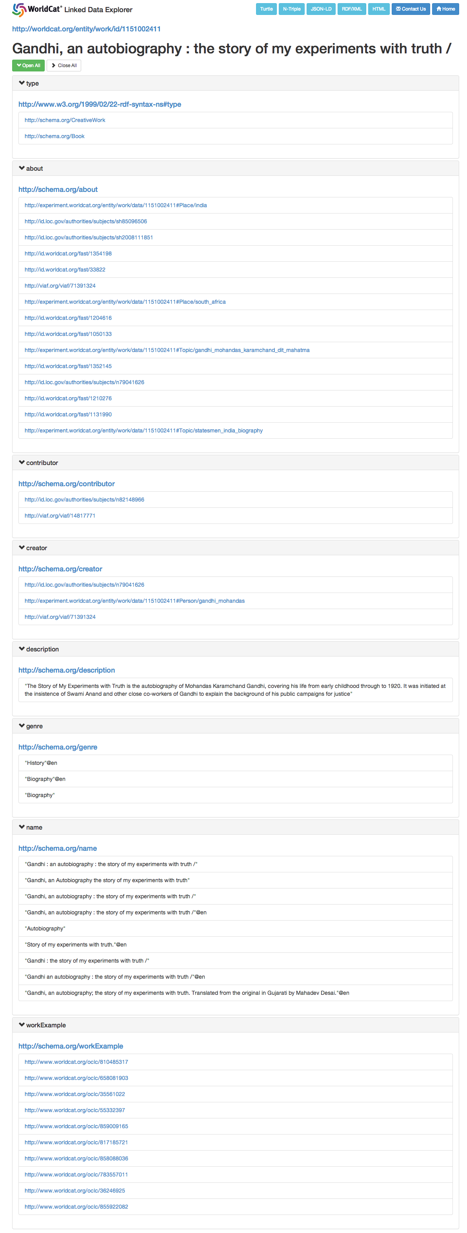
Notes:
Its nearly all links! – relationships to other entities Using the Schema.org vocabulary.
Links to the individual examples of this work

Slide 30
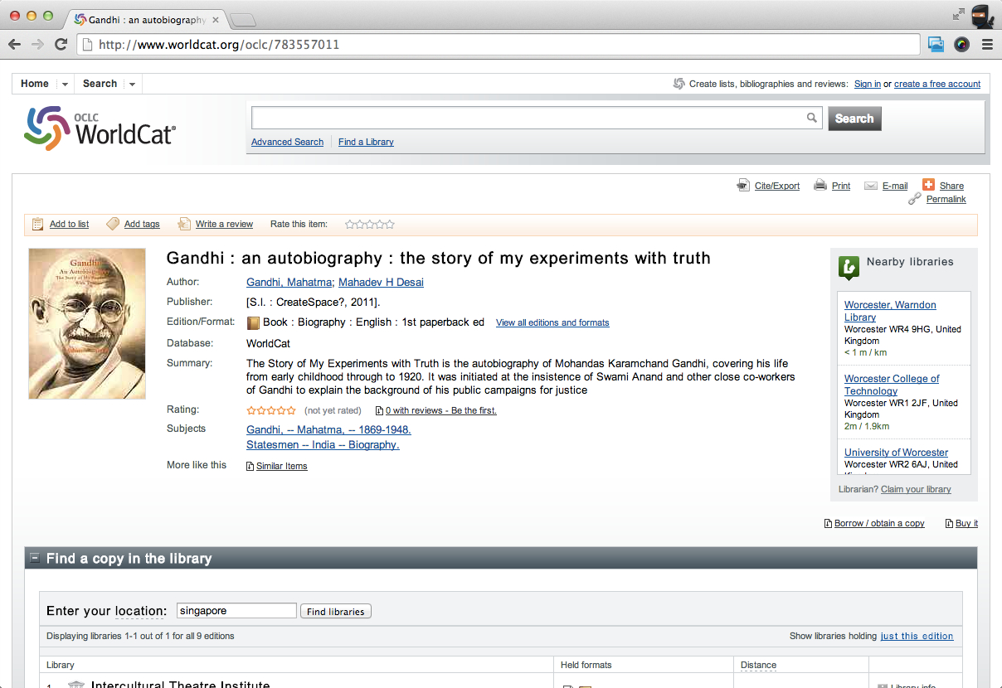
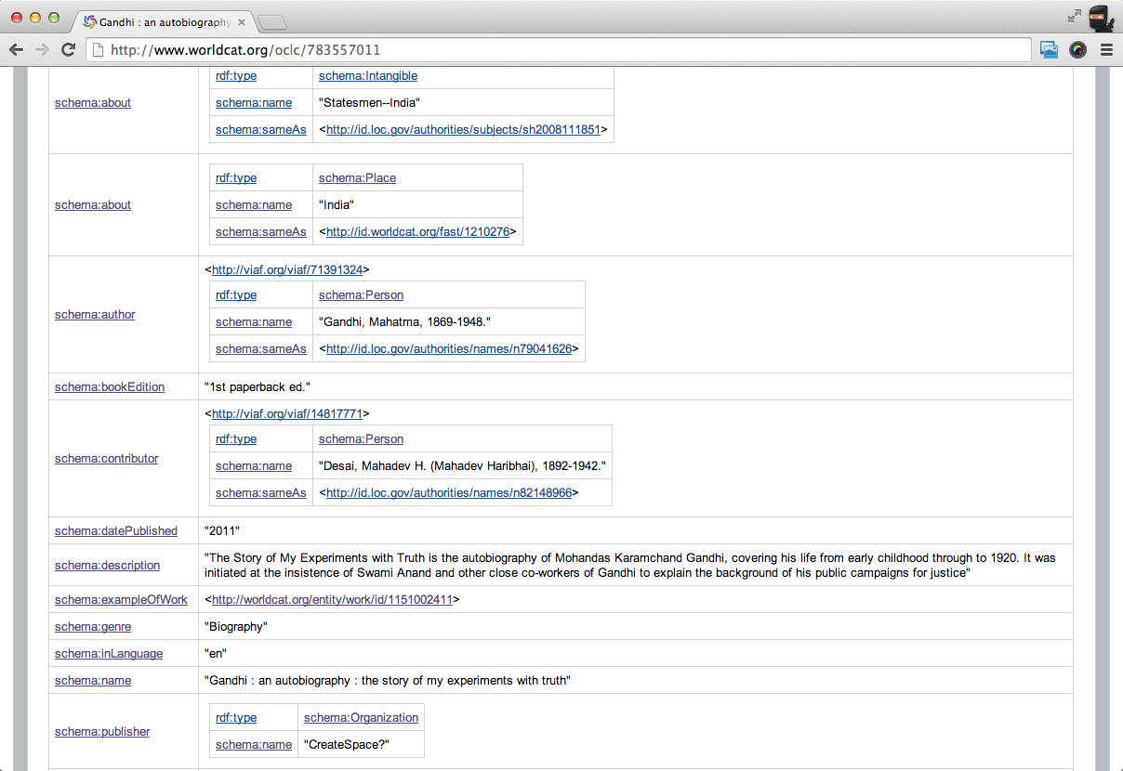
Notes:
The Schema.org linked data relating back to the Work – forming a graph of relationships

Slide 31
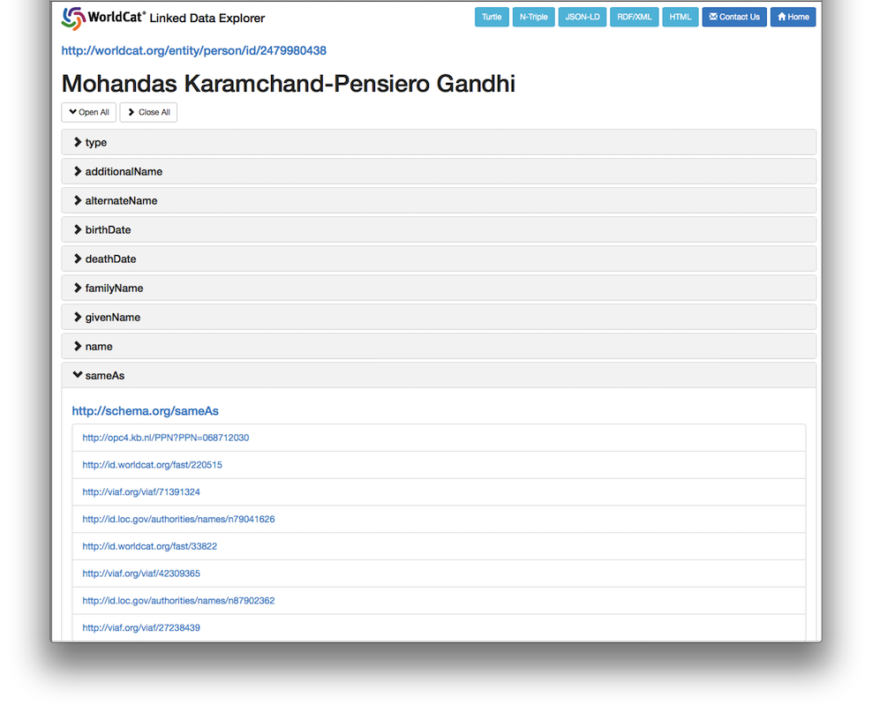
Notes:
A person entity – approx 100 million - to be released soon

Slide 32
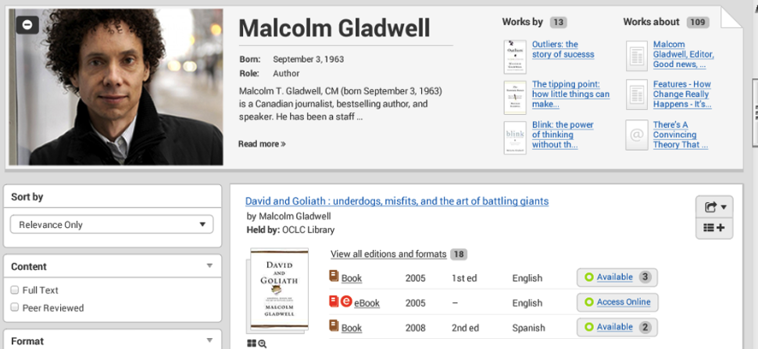
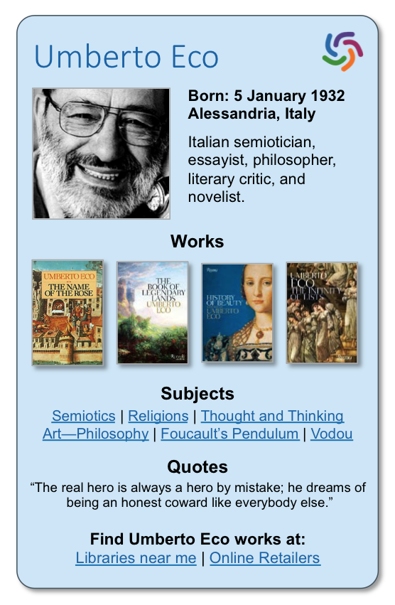

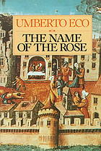
Entities and library workflows
Discovery
The Name of the Rose
Summary: The year is 1327. Franciscans in a wealthy Italian abbey are suspected of heresy, and Brother William of Baskerville arrives to investigate. His delicate mission is suddenly overshadowed by seven bizarre deaths that take place in seven days and nights of apocalyptic terror.
Subjects
Monastic libraries -- Italy – Fiction | Semiotics -- Fiction
Borrowing Options
eBooks | Printed Books | Audio Books
Other Languages
Notes:
Data to underpin innovation! - A person knowledge card in a prototype WorldCat Discovery interface

Slide 33
A Web of Data
http://www.opte.org/
Notes:
So by using the technques, technologies & vocabularies of the web we can fill that black hole and become authoritative hubs of data in the web

Slide 34
person
place
author
object
concept
item
availability
subject
The solution starts here.
organization
work
The library knowledge graph
A graph of relationships
Notes:
We, at OCLC, with our major data ingest and processing techniques – Big Data tech
Matching incoming data with what we have
Identifying the entities and associating their role attributes
Works – not so far very visible in libraries – important on the web
Building a graph of relationships

Slide 35
person
place
object
concept
organization
work
The library knowledge graph
A graph of relationships

Slide 36

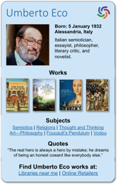


What will be better?
Discovery
Integration with the web
Cataloging
Cataloging
ILL and Analytics
The library knowledge graph
Lots of things….if we do it right.

Slide 37

Entities and library workflows
Cataloging
Cataloging will be different…
  Managing the quality of Works
    Improving clusters
  Managing the quality of Persons
    Links to works, Other IDs

Slide 38

So what progress have we made?
What has OCLC done?
Photo credit: http://media02.hongkiat.com/freebies-for-web-designers-2011/progress-bar.jpg

Slide 39

http://www.oclc.org/data
The Work Entity
197+ million Work descriptions and URIs
Schema.org + BiblioGraph.net
RDF Data formats
  RDF/XML, Turtle, Triples, JSON-LD
Links to WorldCat manifestations
Links to Dewey, LCSH, LCNAF, VIAF, FAST
Open Data license via Linked Data Explorer
  2015: Discovery API, Metadata API
Released April 2014

Slide 40
http://www.oclc.org/data
The Person Entity
98+ million Person descriptions and URIs
    Person entities with authority: 20.2 million
    Person entities without authority: 78.3 million
Schema.org + BiblioGraph.net
Harvested from WorldCat data and enriched from other hubs RDF Data formats
  RDF/XML, Turtle, Triples, JSON-LD
Links to WorldCat Works. Added links from WC Works.
Open Data license via Linked Data Explorer
  2015: Linked Data Explorer, Discovery API
Notes:
Refined from 320M harvested entities.
f there is a 100 or 700 field for a Person entity, then there will be a BY relationship (creator, contributor, author, illustrator, etc) in the WC Work description that includes a WC Person URI.
If there is a 600 field for a Person entity, then there will be an ABOUT relationship (subject, etc) in the WC Work description that includes a WC Person URI.
Other sources:
After creating the set of Person entities, we started the process of enriching the entities with data harvested from other sources - images and other information from DBPedia, preferred names from LC, see also links from VIAF, and profile information (subjects, genres, and roles most known for) from WC Identities.

Slide 41

Can we measure impact?
Photo credit: http://measuringupblog.com/app/wp-content/uploads/2013/11/blogpic2.jpg

Slide 42
Monthly Unique Visitors
Notes:
Vistior number grow as the graph is exposed

Slide 43

Linked Data
A Technology
Standard on the Web – RDF, URIs, Vocabularies
Identifying and Linking resources on the Web
Important powerful enabling technology
But only a technology…
for the systems folks to worry about
Real benefits flow from:
Entity Based Data Architecture
Powered by Linked Data

Slide 44
OCLC Entity Based Data Strategy
2010
VIAF, ISNI, FAST Publish Linked Data
WorldCat.org Linked Data Release – using Schema.org
Data mining of WorldCat resources
WorldCat Works Released – using Schema.org
Schema.org added to VIAF RDF
WorldCat Discovery API Returns Schema.org RDF (Beta)
2012
2013
2014
Application Integration
  WorldCat Discovery
  Analytics
  Discovery API
  Cataloging
More Entities Released
  Person
  Organization
  Event
  Concept
2015
New Products
Continuing Evangelism
New Services
Continuing Innovation
2016

Slide 45
Many great Library Linked Data Initiatives
but
If users can't discover our resources
What is the point?
Give the Web what it wants!

Slide 46
Linked Data has benefits for library workflows ….
….by giving the Web what it wants
The Web of Data is Our Oyster

Slide 47
CEAL 2015 AAS Chicago
The Web of Data is Our Oyster
Richard Wallis
OCLC Technology Evangelist
@rjw

